Slide 1
Software Design for Cloud 2_3
Python Programming
Lecture 3
Polymorphism

Slide 2
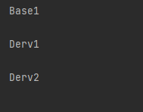
class Base:
def myPrint1(self):
print("Base1")
class Derv1(Base):
def myPrint1(self):
print("Derv1")
class Derv2(Base):
def myPrint1(self):
print("Derv2")
def main():
obj1=Base()
obj2=Derv1()
obj3=Derv2()
list = [obj1,obj2,obj3]
for el in list:
el.myPrint1()
print()
main()

Slide 3
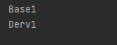
class Base:
def myPrint1(self):
print("Base1")
class Derv1(Base):
def myPrint1(self):
print("Derv1")
def main():
base=Base()
derv=Derv1()
base.myPrint1()
base=derv
base.myPrint1()
main()

Slide 4
Another Example
class Data:
def __init__(self, val1, val2):
self._value1 = val1
self._value2 = val2
def add(self):
return 0
def printData(self):
print('Data= ', self._value1, ':', self._value2, end='')

Slide 5
Another Example
class Pair(Data):
def __init__(self, val1, val2):
super().__init__(val1,val2)
def add(self):
return self._value1 + self._value2
def printData(self):
super().printData()
class Treble(Data):
def __init__(self, val1, val2, val3):
super().__init__(val1, val2)
self._value3=val3
def add(self):
return self._value1 + self._value2 + self._value3
def printData(self):
super().printData()
print(':', self._value3, end='')

Slide 6
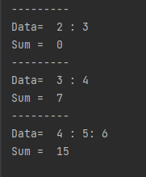
def main():
obj1=Data(2,3)
obj2=Pair(3,4)
obj3 = Treble(4, 5, 6)
list = [obj1, obj2, obj3]
for el in list:
print('---------')
el.printData()
print('\nSum = ', el.add())
main()

Slide 7
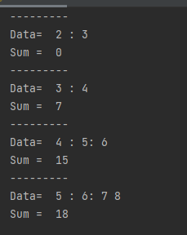
Ex231
Modify the application so there is one more ‘
concrete’ class Quad giving the output shown
Note: Need to modify the main method to
include a 4th object of type Quad

Slide 8
Ex232
Given the base class Operation and
main method shown
class Operation:
def __init__(self, val1):
self._value1 = val1
def op(self):
return 0
def readType(self):
return 'Base Operation'
def printData(self):
print(self.readType())
print('Initial Value= ', self._value1)
def main():
obj1=Increment(1)
obj2=Decrement(4)
obj3=Double(6)
list = [obj1, obj2, obj3]
for el in list:
print('---------')
el.printData()
print('Result = ', el.op())
main()

Slide 9
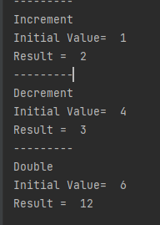
Ex232
Operation:_____
value1 (int)___
__init__(int)
Str readType()
int op()
printData()
Increment:_____
_____________
__init__(int)
Str readType()
int op() # value+1
Decrement:_____
_____________
__init__(int)
Str readType()
int op() # value-1
Decrement:_____
_____________
__init__(int)
Str readType()
int op() # value*2

Slide 10
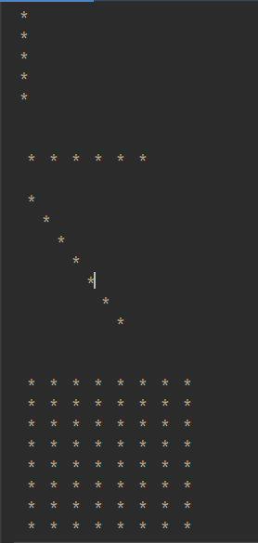
Ex233
class Line:
def __init__(self, length):
self._length = length
def draw(self):
print('Base Class’)
--------------------------------------------------
class VertLine(Line):
def __init__(self, length):
super().__init__(length)
def draw(self):
print()
for i in range(self._length):
print(' *'))

Slide 11
Ex233
Line:_____
length (int)___
__init__(int)
draw()
def main():
obj1=VertLine(5)
obj2=HorzLine(6)
obj3 =SlashLine(7)
obj4 =Square( 8)
list = [obj1, obj2, obj3, obj4]
for el in list:
print('')
el.draw()
VertLine:__
_________
__init__(int)
draw()
HorzLine:__
_________
__init__(int)
draw()
SlashLine:__
_________
__init__(int)
draw()
Square:__
_________
__init__(int)
draw()

Slide 12
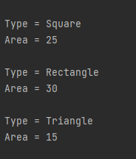
Ex234
class Shape:
def __init__(self, width):
self._width = width
def readType(self):
return 'Base Shape'
def area(self):
return 0
class Square(Shape):
def __init__(self, width):
super().__init__(width)
def readType(self):
return 'Square '
def area(self):
return self._width * self._width

Slide 13
Ex234
Shape:_____
width(int)___
__init__(int)
str readType()
int area()
def main():
obj1=Square(5)
obj2=Rectangle(5,6)
obj3 =Triangle(5,6)
list = [obj1, obj2, obj3]
for el in list:
print('\nType =',el.readType())
print('Area =',el.area())
Square:_____
__init__(int)
str readType()
int area()
Rectangle:_____
height (int)
__init__(int,int)
str readType()
int area()
Triangle:_____
height (int)
__init__(int,int)
str readType()
int area()

Slide 14
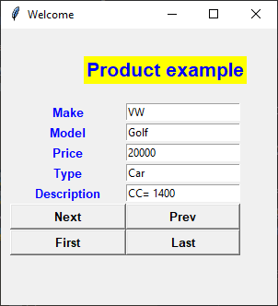
Ex235
class Product:
def __init__(self, make, model, price):
self.__make = make
self.__model = model
self.__price = price
def getMake(self):
return self.__make
def getModel(self):
return self.__model
def getPrice(self):
return self.__price
def readType(self):
return "Basic Product"
def readDescription(self):
return ""
Given the base class Product

Slide 15
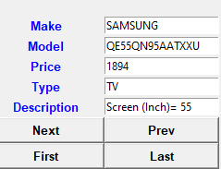
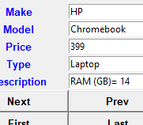
Ex235

Slide 16
Ex235
Product:_________
make (str)
model (str)
_price__(int)______
__init__(str,str,int)
str getMake()
str getModel()
int getPrice()
str readType()
str readDecription()
Car:________________
_engine (int)_________
__init__(str,str,int,int)
str readType()
str readDecription()
Laptop:_____________
_ram (int)_____ _____
__init__(str,str,int,int)
str readType()
str readDecription()
TV:________________
_screen (int)_________
__init__(str,str,int,int)
str readType()
str readDecription()

